Slide 1

CSE302:COMPUTER NETWORKS PROJECT
SECURE E-VOTING USING QR-CODE
PRESENTED BY
124157058 – VALAVAN K S
GUIDE NAME: Dr.R.KAVITHA,CSE/SOC,SASTRA UNIVERSITY

Slide 2
POINTS TO BE DISCUSSED
-ABSTRACT
-INTRODUCTION
-SOFTWARE REQUIRED
-ARCHITECTURE DIAGRAM
-DATA FLOW DIAGRAM
-MODULES
-OUTPUT
-CONCLUSION
-FUTURE ENHANCEMENT

Slide 3
ABSTRACT
Voting system is very essential for electing leaders to lead our nation. Nowadays, e-voting is developed to make easy for citizens of India to vote through online without visiting polling booth. E-voting would be the security risk that can be potentially undermine the election process. It may susceptible to a range of threats such as hacking by domestic and foreign saboteurs. In order to address this issues , our proposed system uses QR code for safe voting

Slide 4
INTRODUCTION
In every democracy, the security of an election is a matter of national security. The computer security field has for a decade studied the possibilities of electronic voting systems , with the goal of minimizing the cost of having a national election, while fulfilling and increasing the security conditions of an election. From the dawn of democratically electing candidates, the voting system has been based on pen and paper. Replacing the traditional pen and paper scheme with a new election system is critical to limit fraud and having the voting process traceable and verifiable. Electronic voting machines have been viewed as flawed, by the security community, primarily based on physical security concerns. Anyone with physical access to such machine can sabotage the machine, thereby affecting all votes cast on the aforementioned machine.

Slide 5
SOFTWARE REQUIRED
Operating System : Windows
Front-End : HTML , CSS
Web Server : Apache
Back End : MySQL , PHP

Slide 6
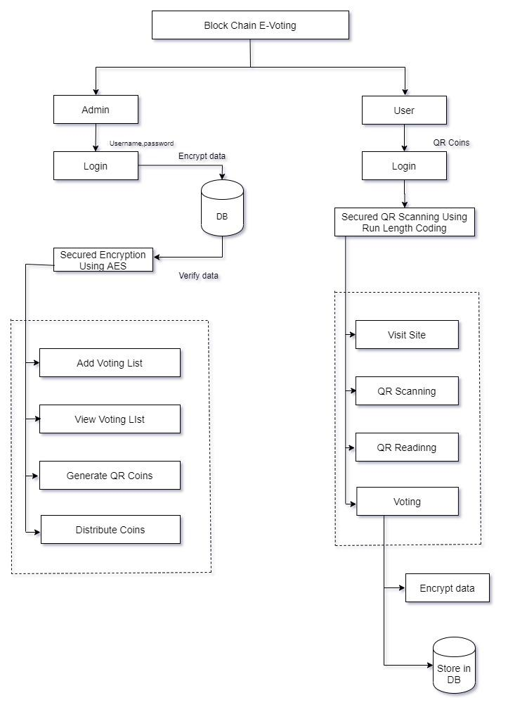
ARCHITECTURE DIAGRAM

Slide 7
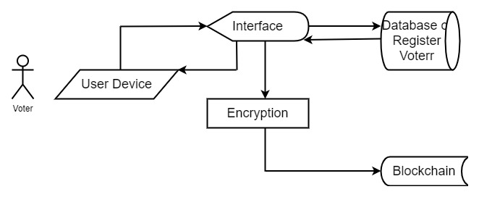
DATA FLOW DIAGRAM

Slide 8
MODULES
USER MODULES
Visit Site
The user first visits the site where they have to cast the vote.
Apply Candidate
In this module, public users who are willing to apply for candidate can apply here by providing required details. All applied candidate can be elected as candidate. Admin only approve candidate.
QR Scanning
After the QR Coin is generated, the user can view the site only at the particular date and time and only at this time the user can view and access the site
and the user can scan QR .
QR Reading
In this project we can read our QR code by browsing and add QR image into our QR reader. We have alternative QR reading technology by using the scanner. Once we scan the QR and submit it into the QR reader the scanned image will be retrieved and the user can see the information provided in the decrypted QR. After scanned the QR and the information provided in the image will be decrypted.
Polling
After the QR is scanned, the user can poll votes. The user can view to whom they want to vote and poll accordingly and the voting details are viewed with database security using Encryption process. The voting process is now more secured.
Database cryptography
In this module, when all the votes are collected, they are stored in database after QR scanning. Each votes are scanned and stored in database after encryption so that authentication becomes even more secure. For this database security,

Slide 9
MODULES
ADMIN MODULES
Manage Voter Details
In this module, the user can add voter list and the admin only can access voter details and can update the voter details as and when necessary.
Generate QR Coin
After adding the details, QR Coin is generated and distributed to the particular user. Only that particular user can view the details and at particular date and time. Only with that QR Coin only the user can cast votes.
Manage Candidate details
In this modules, all applied candidate details will be managed. Admin can approve only particular candidate. And Party symbols will be allocated by admin to approved candidates.

Slide 10
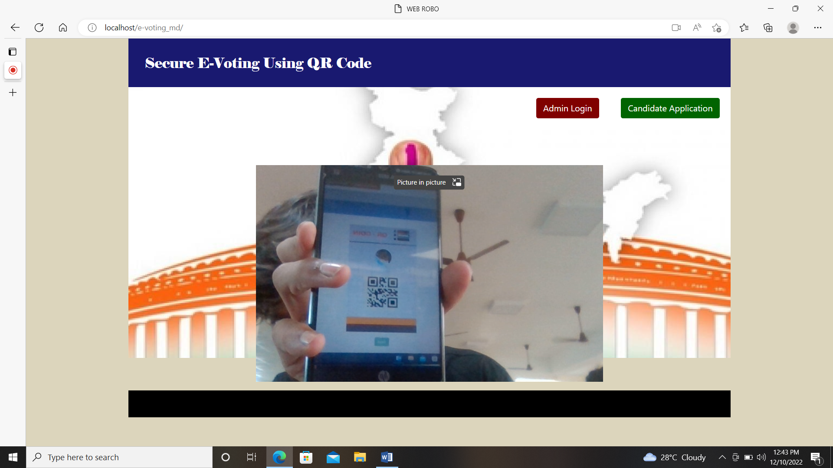
OUTPUTS
Home page:

Slide 11
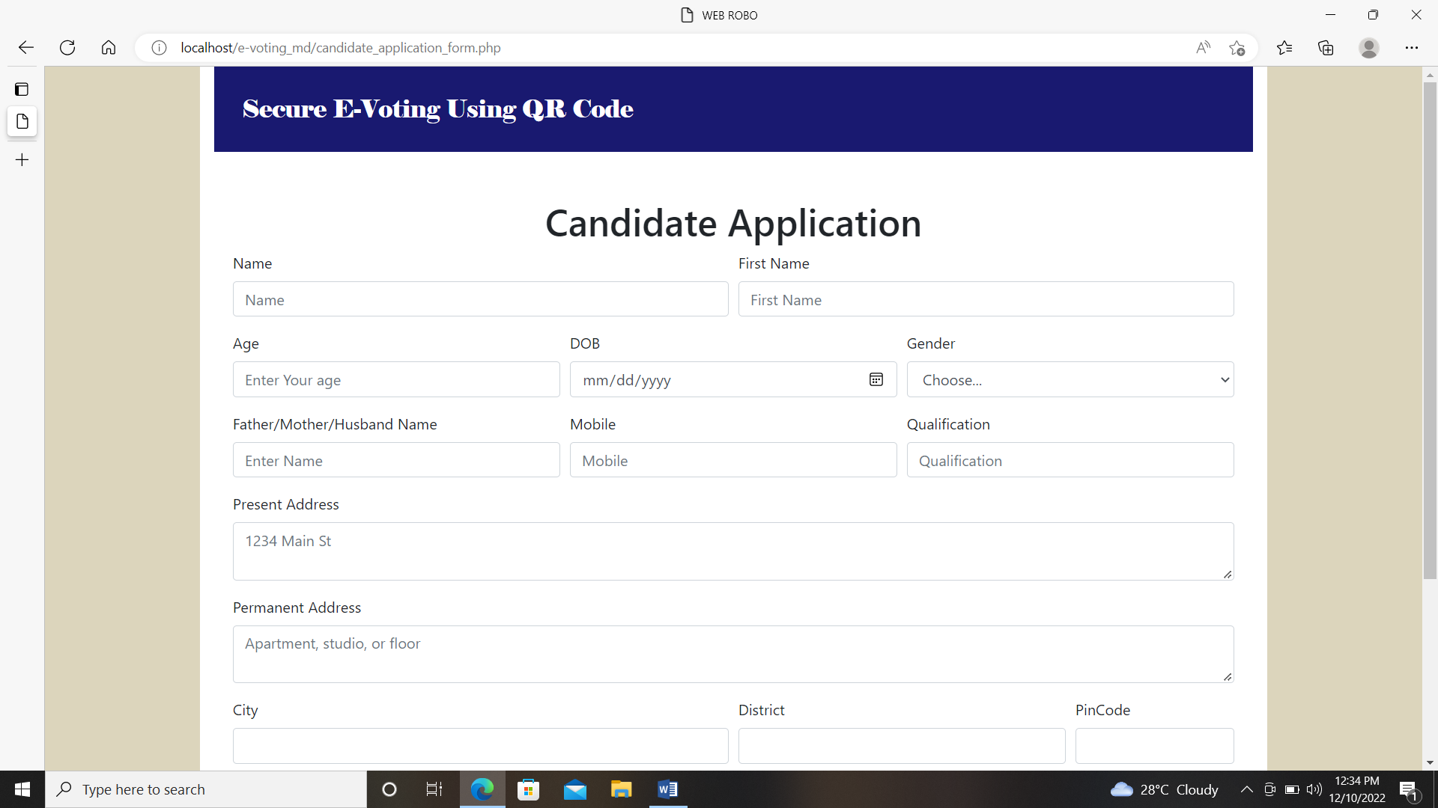
Candidate application

Slide 12
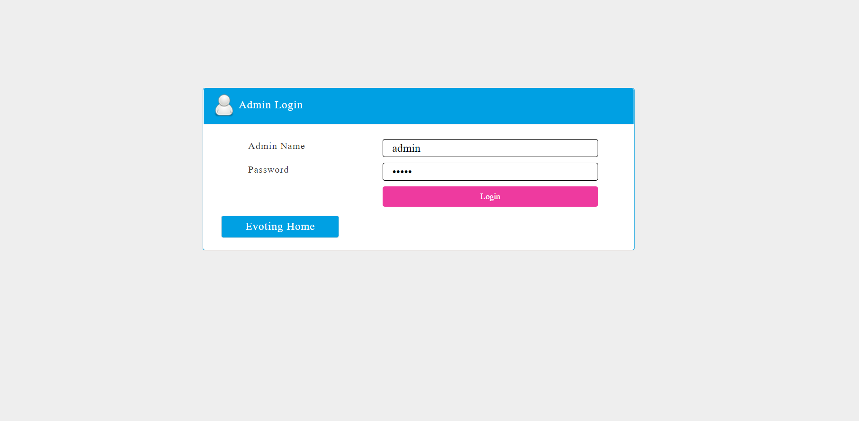
Admin Login

Slide 13
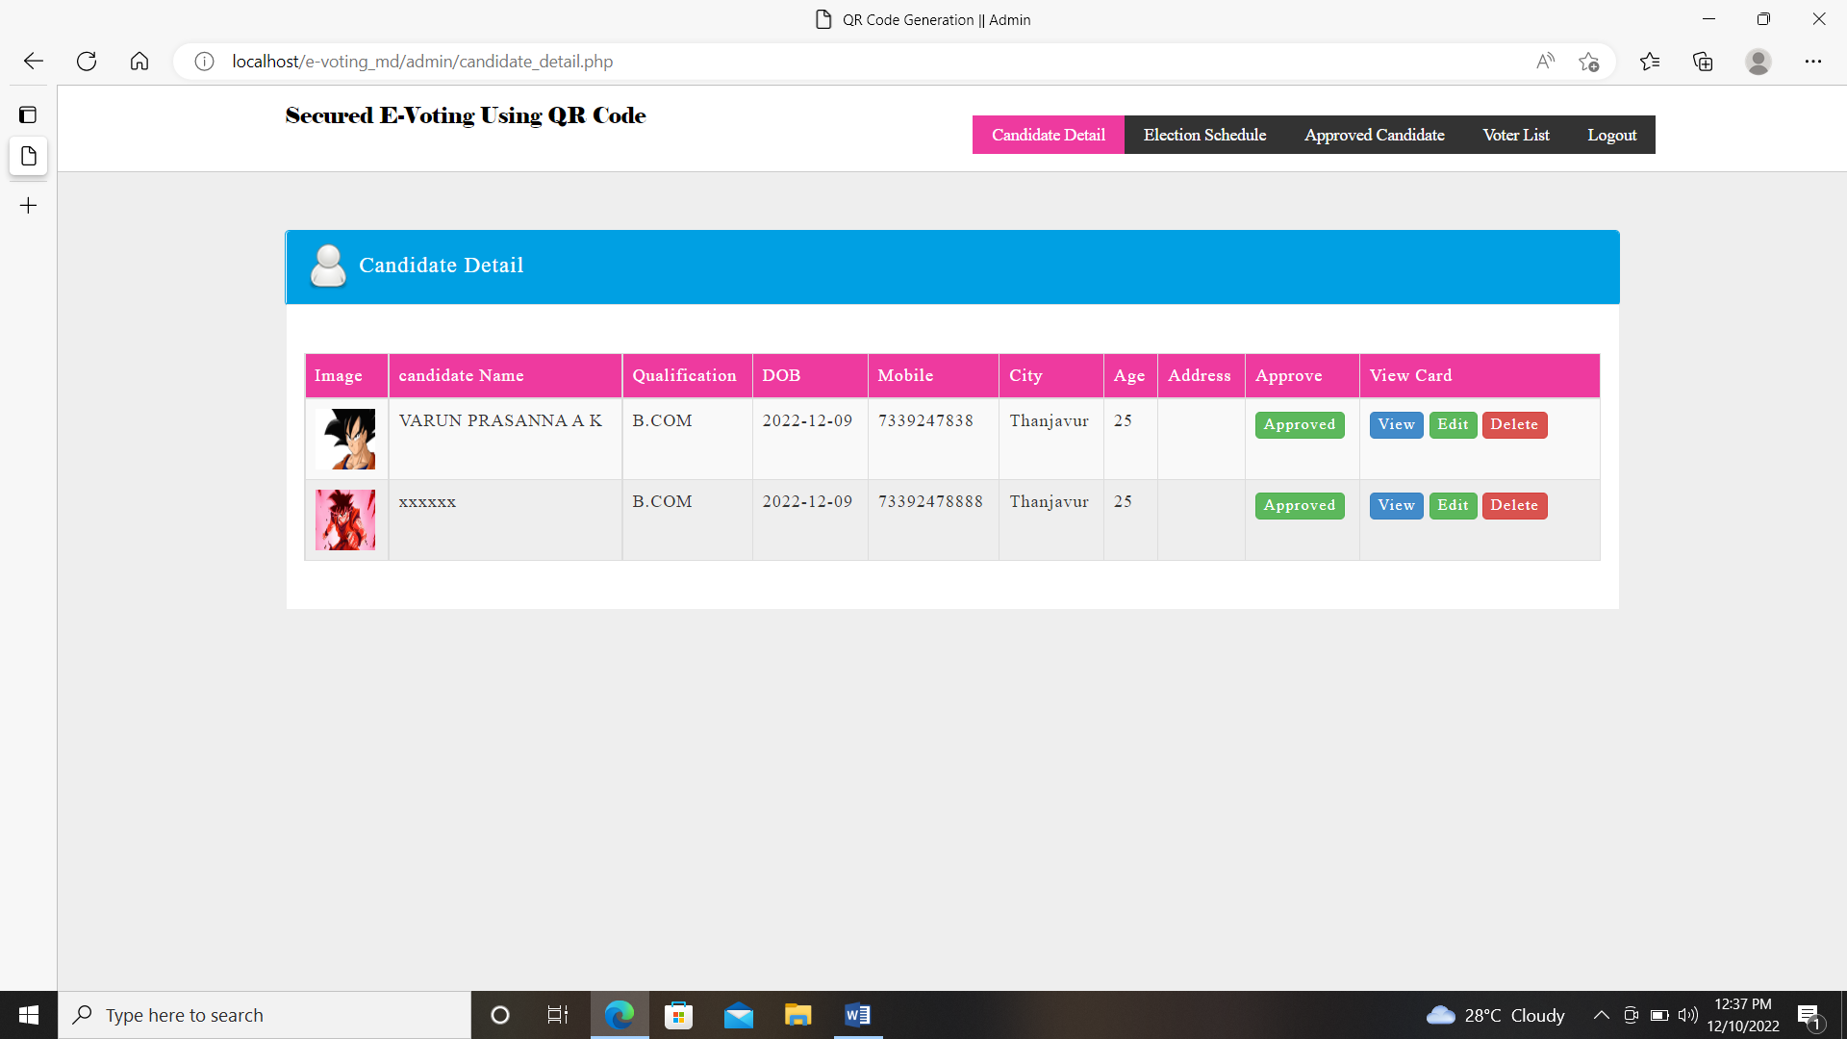
View applied candidates

Slide 14
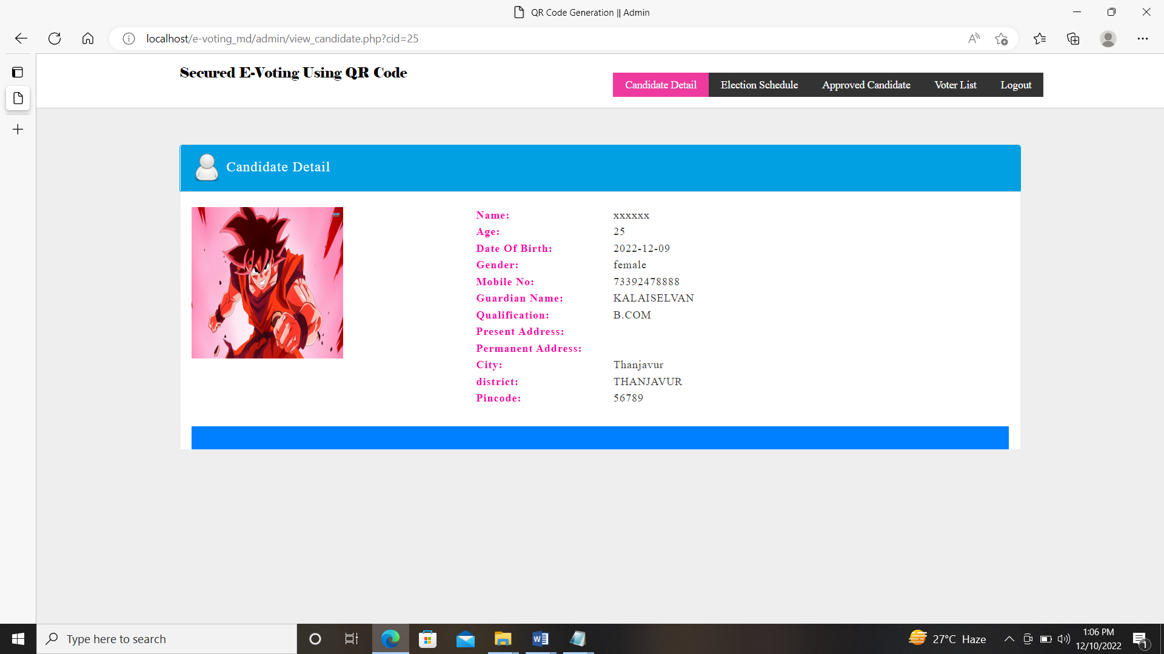
Single view

Slide 15
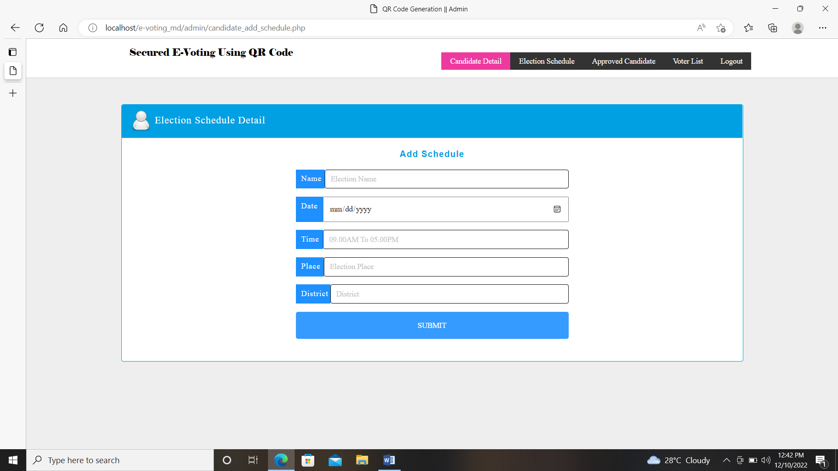
Election schedule

Slide 16
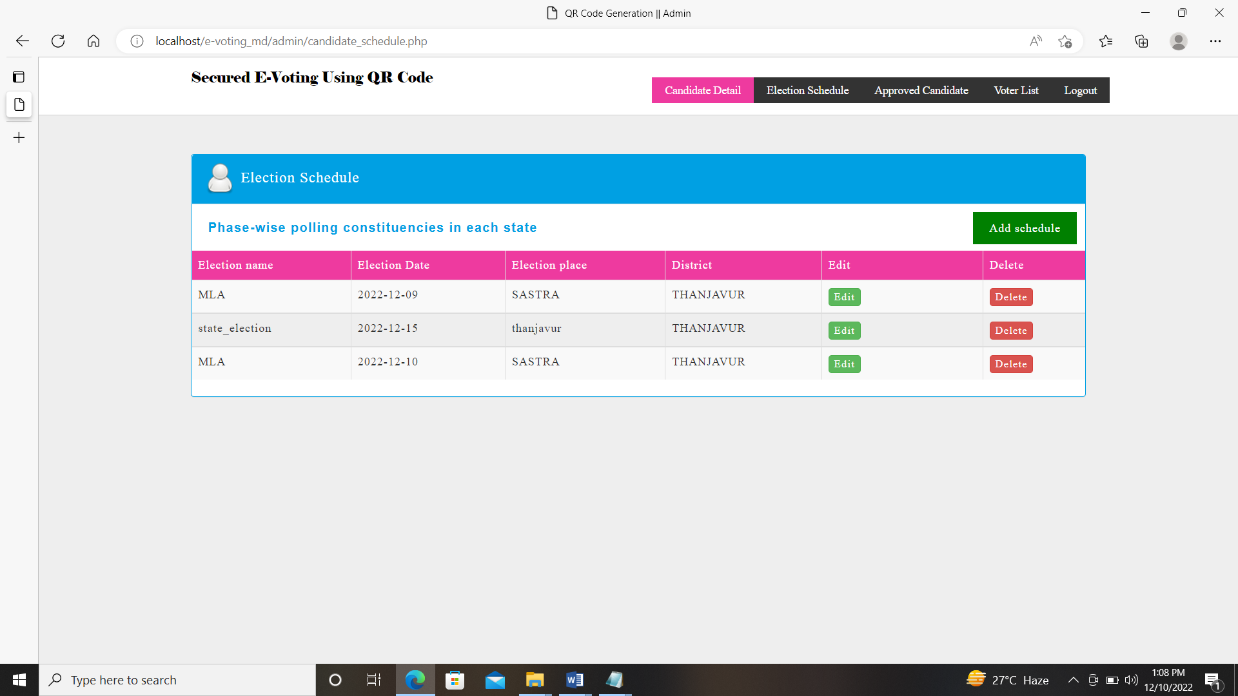
View Election

Slide 17
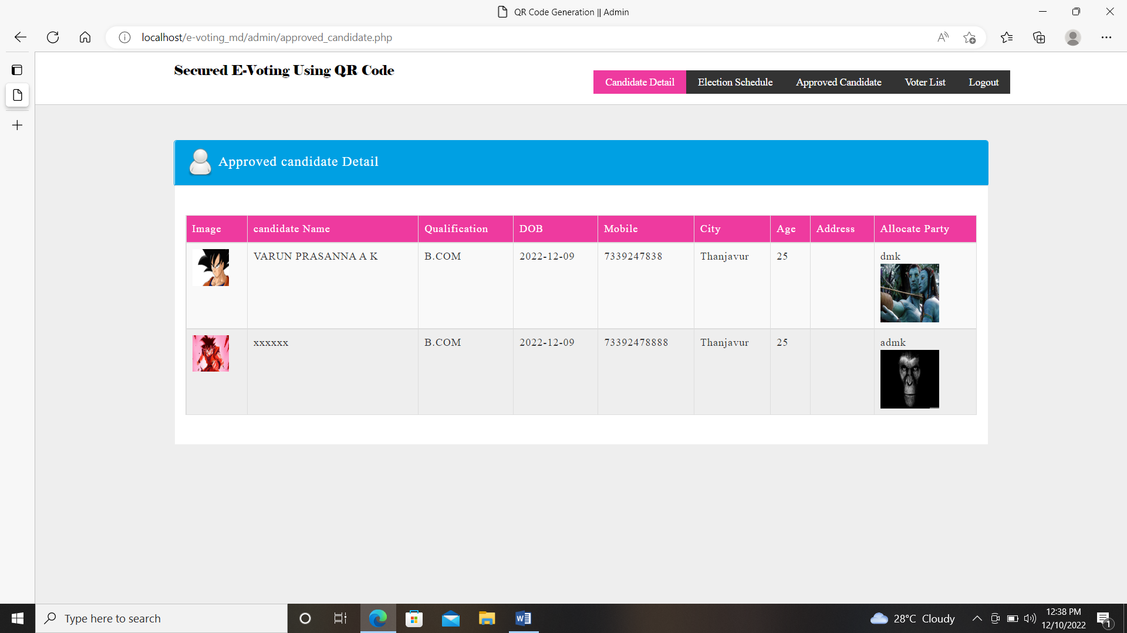
Allocate party

Slide 18
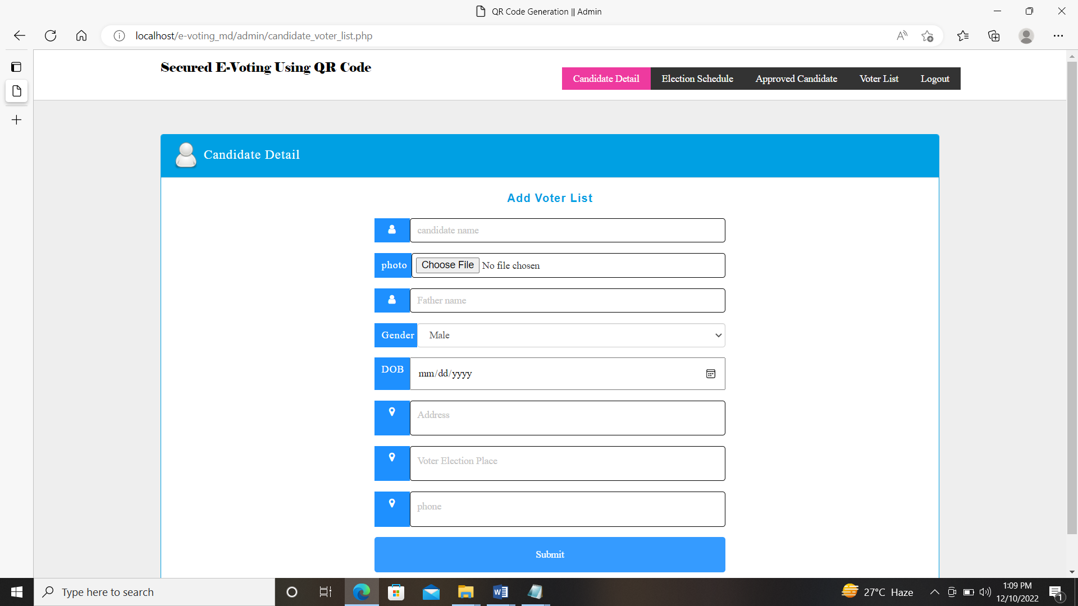
Add Voters

Slide 19
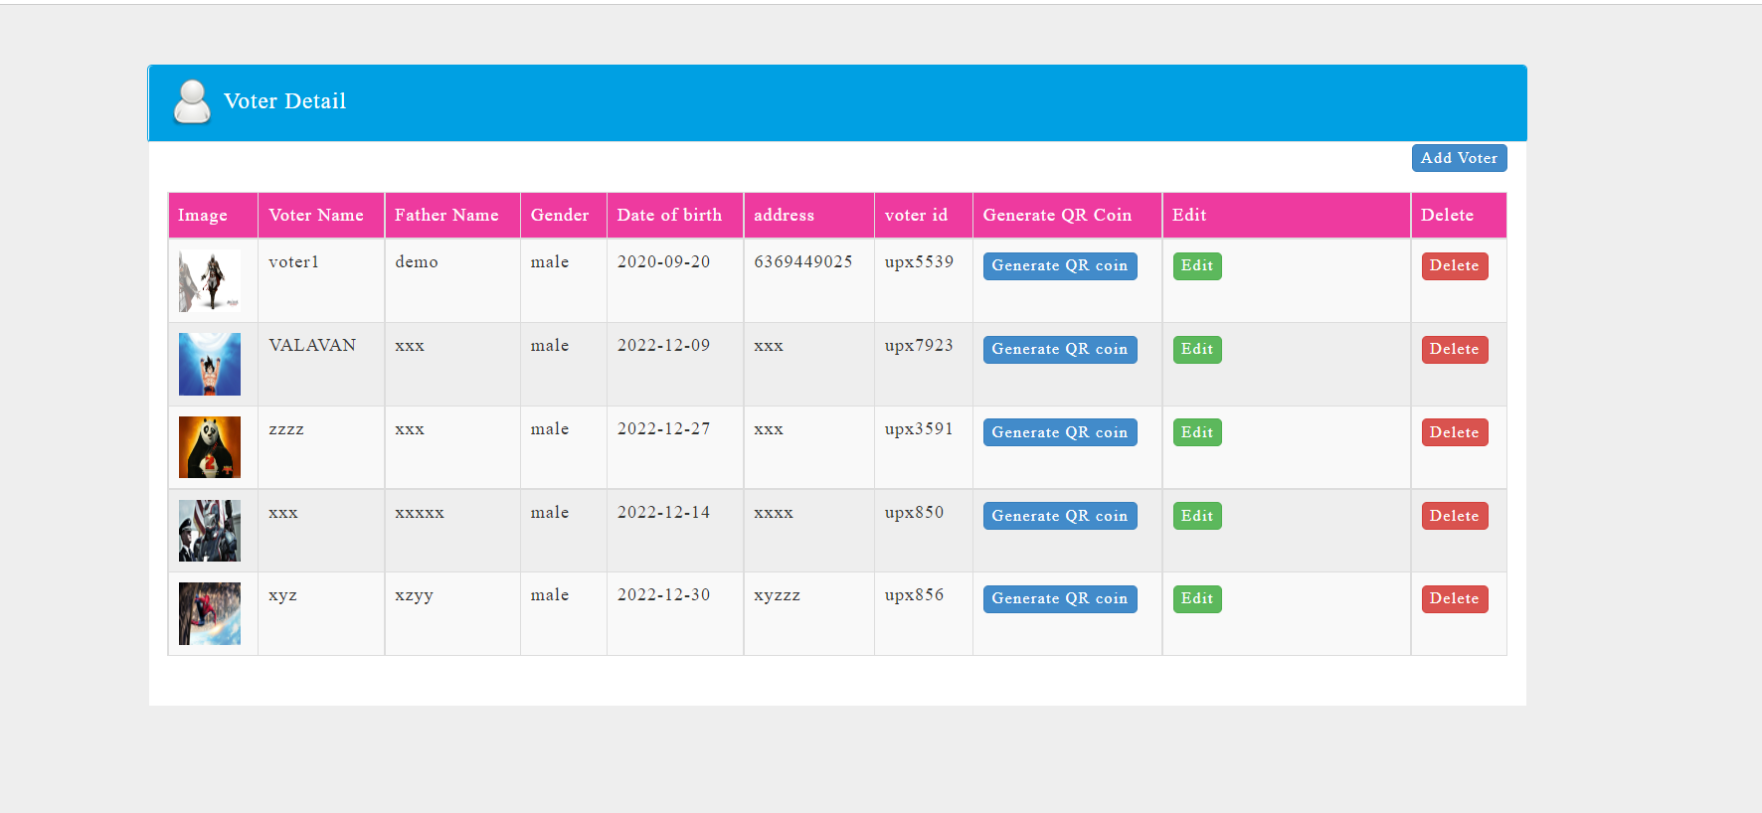
View Voters

Slide 20
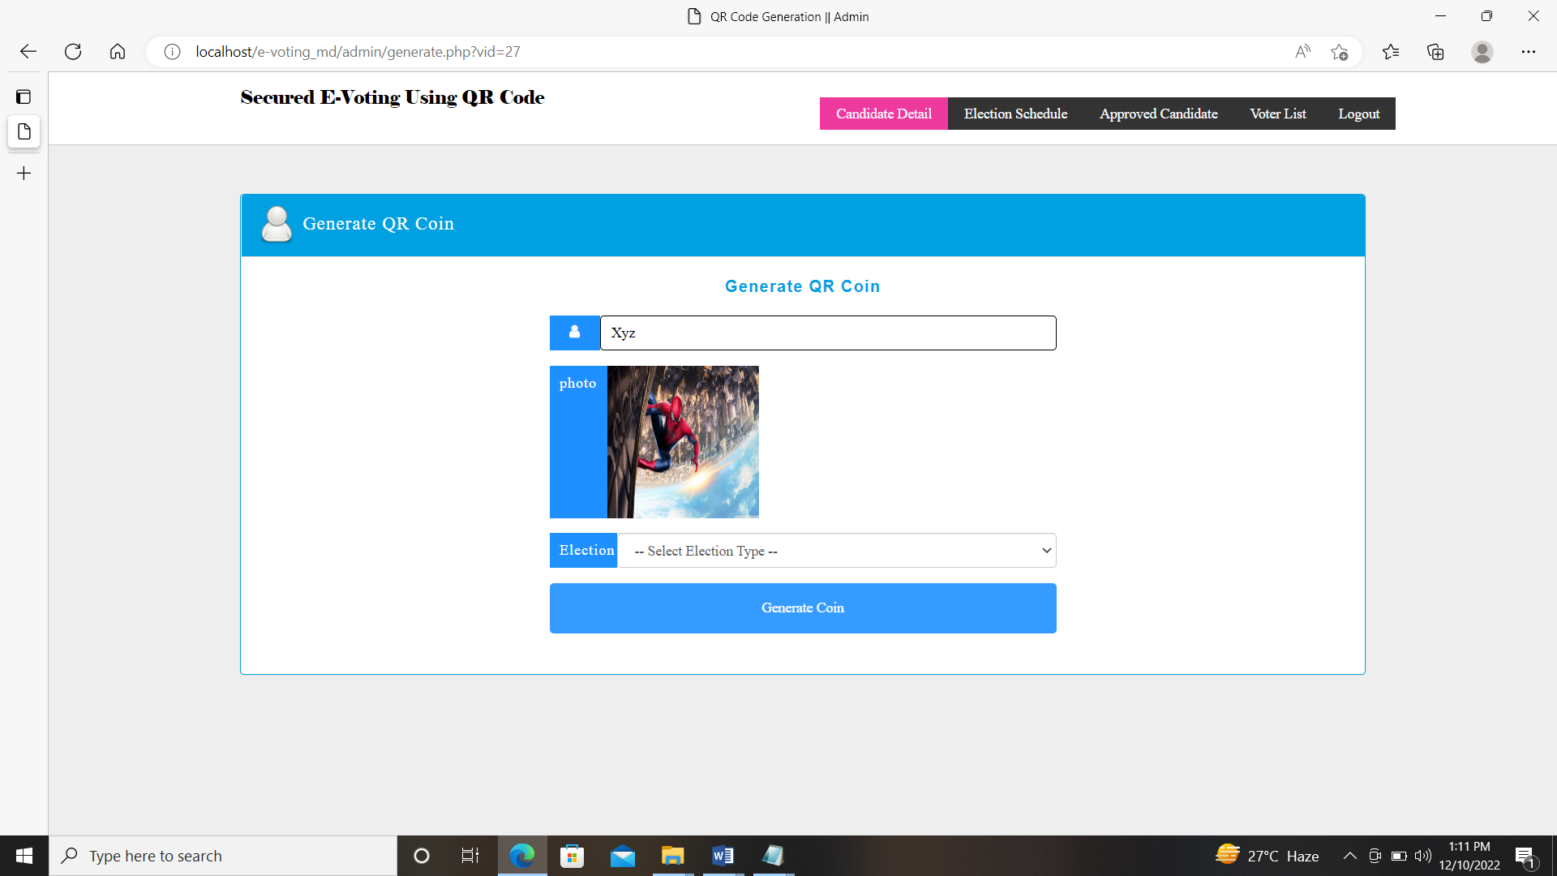
Generate QR coin

Slide 21
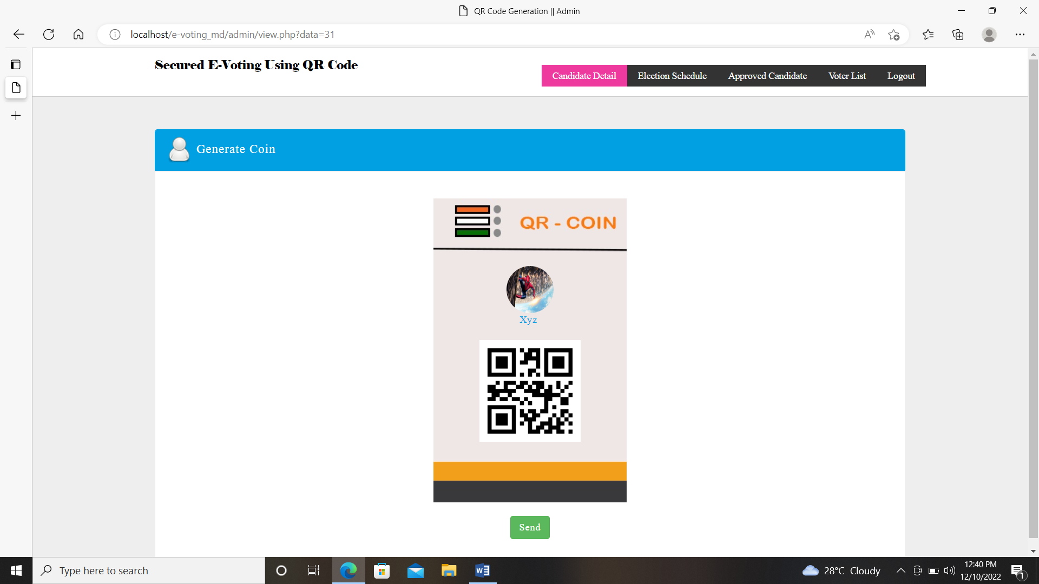
View QR

Slide 22
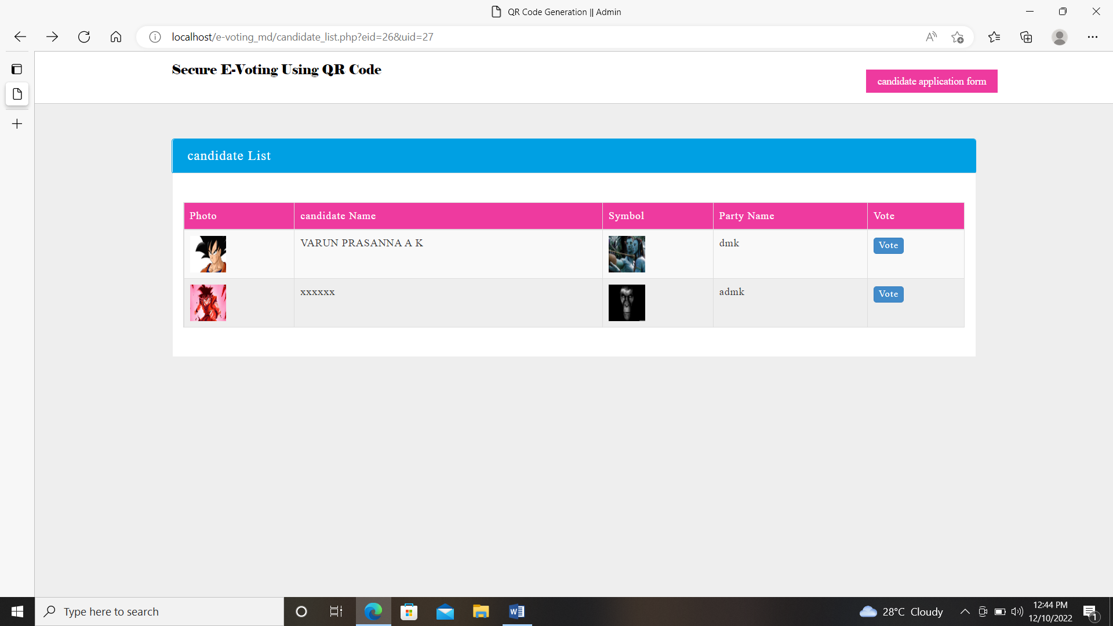
View Candidates to vote

Slide 23
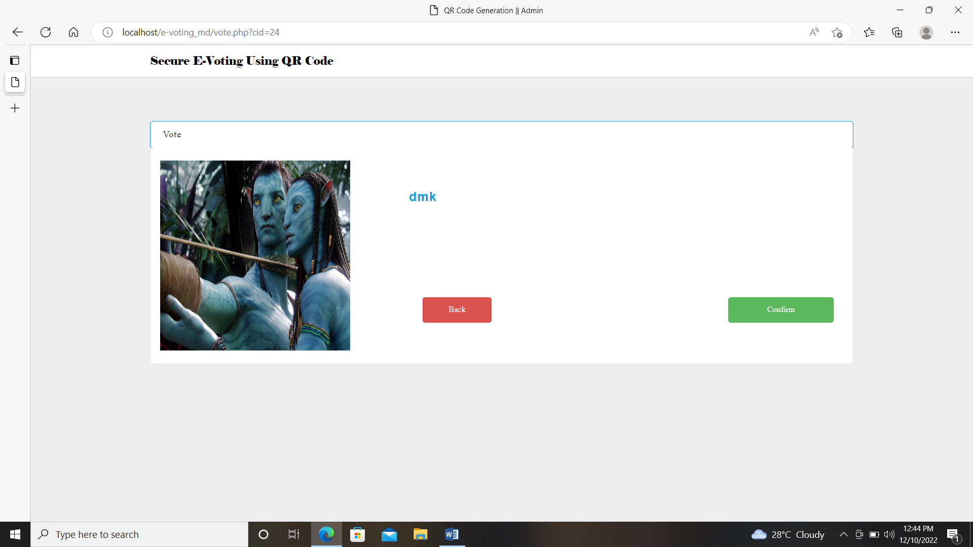
Confirm vote

Slide 24
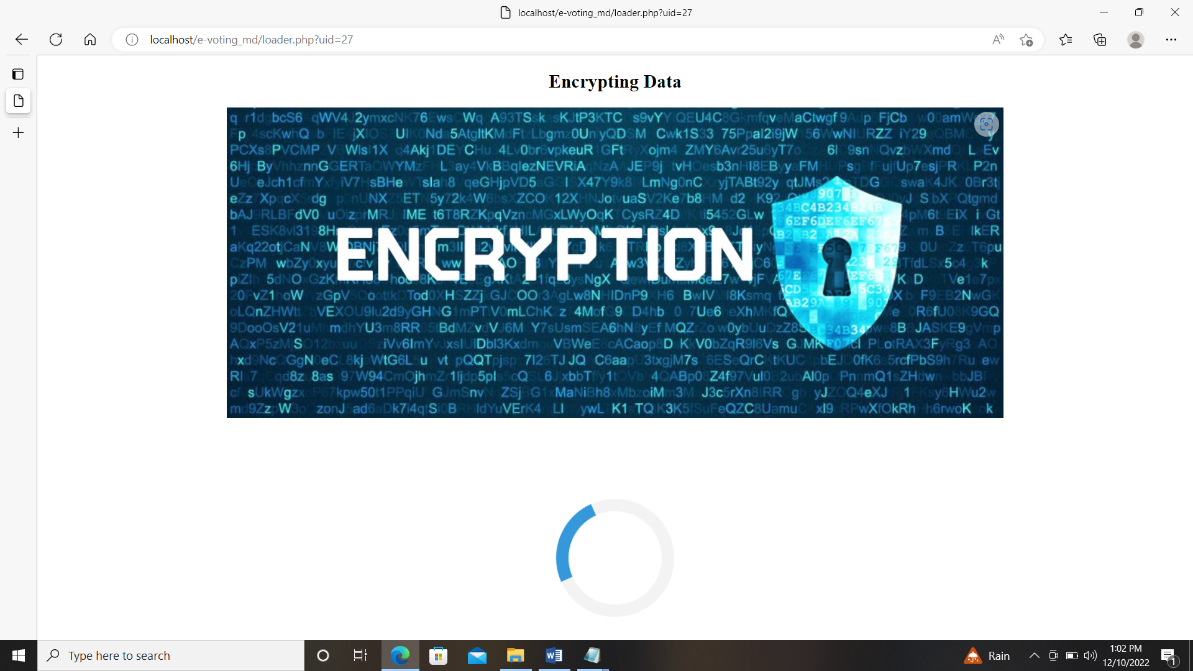
encrypting vote

Slide 25
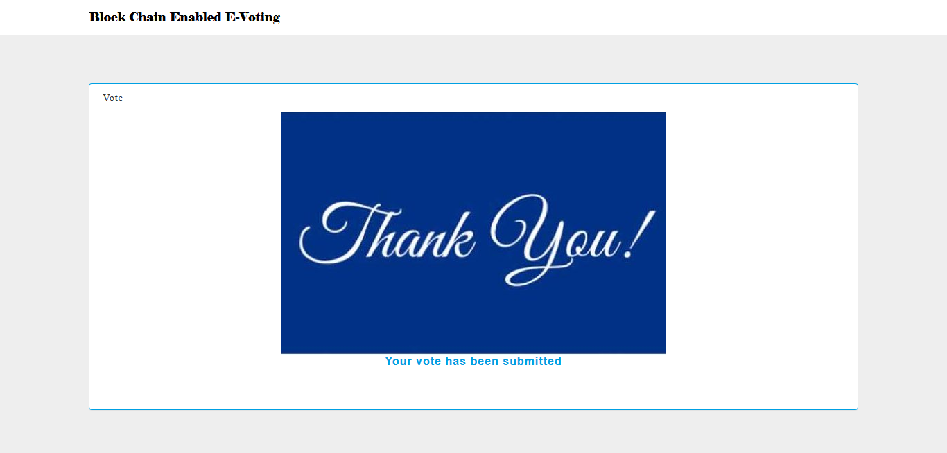
Voted successfully

Slide 26
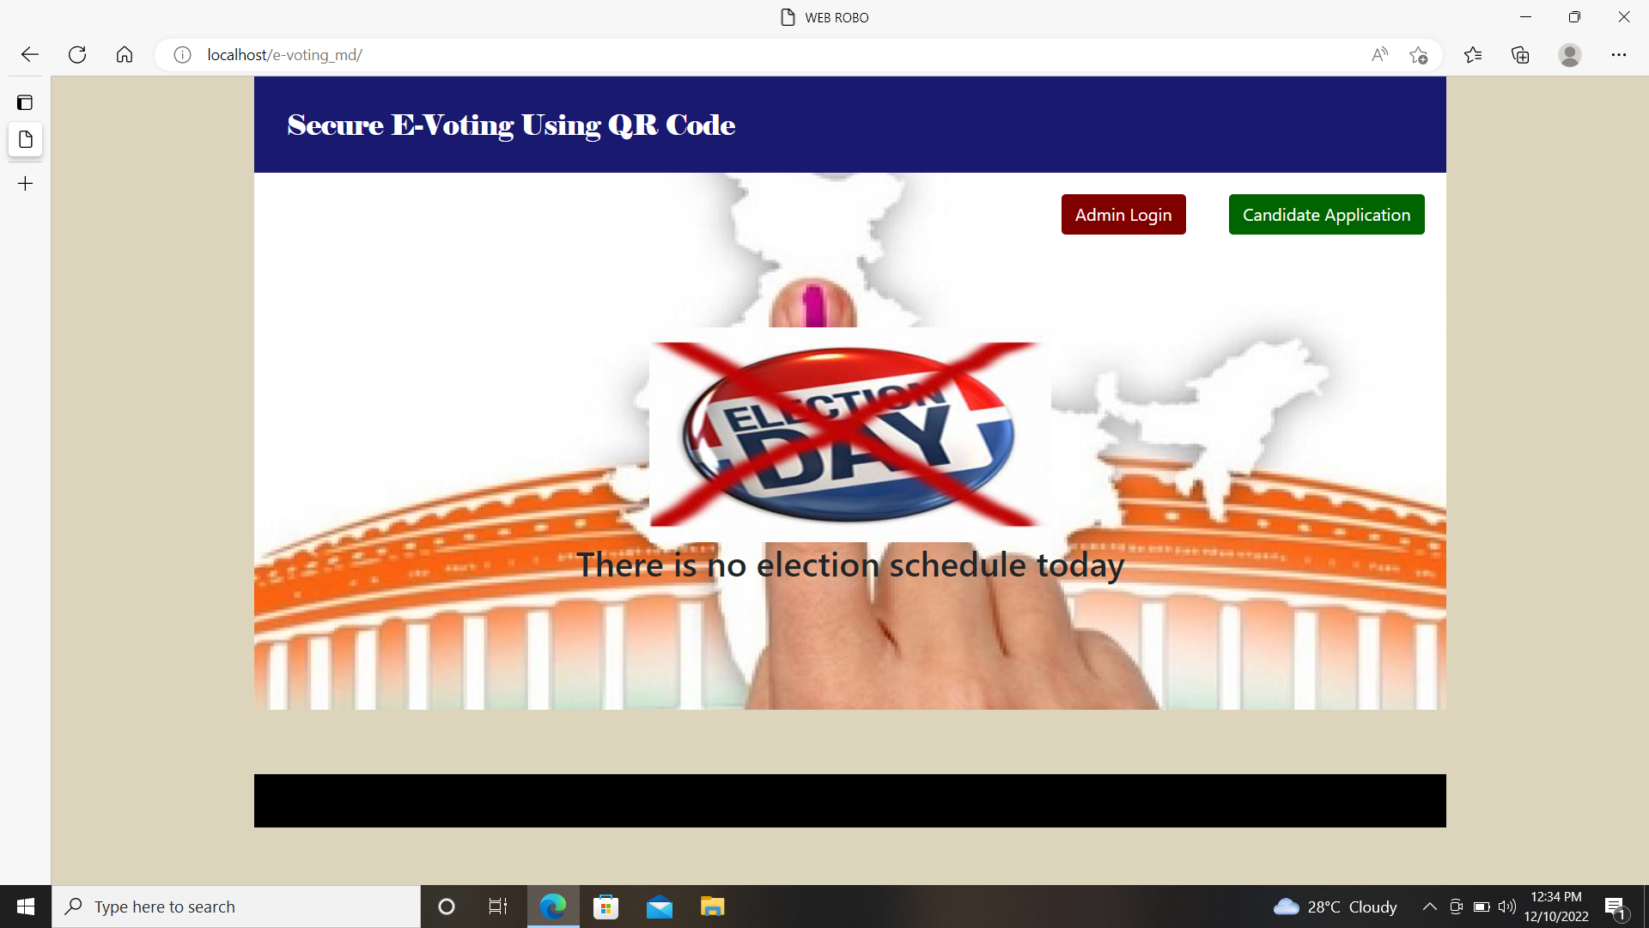
Home page when no election schedule

Slide 27
Conclusion:
E-Voting system is efficient adheres to voting protocol, simple & easy to maintain. It maintains details of voting, voters, candidate & election. It decreased false voting & it has increased voting percentage. Since E-Voting relates to the Internet, there is a possibility of more attackers. Another issue with E-voting is educating the voters. We cannot consider that all the users are having computer knowledge and they will use the E-voting systems easily. Designed E-Voting System must be easy to use. We should consider the fact that a large portion of the voting public has a very little knowledge about the computers. Voting through QR Coin Scanning has been implemented successfully. All votes has been implemented in encryption format.

Slide 28
Future Enhancement
Online voting system done on QR-Code based can be extended to a One Time Password(OTP) and visual cryptography.

Slide 29
THANK YOU!
PRESENTED AS A PART OF THE ‘PROJECT BASED
ASSESSMENT’ FOR THE END-SEMESTER EXAMINATION
ON THE COURSE ‘COMPUTER NETWORKS’
[COURSE CODE : CSE302] FOR THE
ACADEMIC YEAR 2022-2023

